Slide 1

PYTHON TECHIES

Slide 2
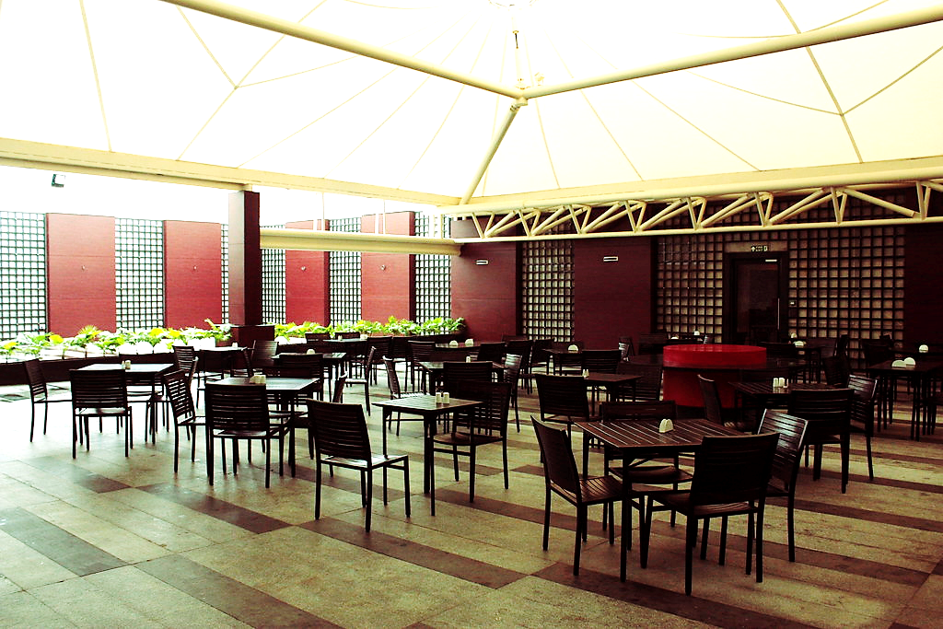
Canteen Management
online

Slide 3

tEAm
K.U.NIKITHA
S.PARINITHA
CH.LOKESH
P.MANI PREETHAM

Slide 4

AGENDA
The main AGENDA of the project is to develop The Billing and Prebooking system in MREC Canteen by making it online

Slide 5

ADVANTAGES
TIME CONSUMPTION REDUCES
MAINTAING SOCIAL DISTANCING
CROWDING IS AVOIDED
CONVINIENCE OF MOBILE ODERING
MORE TIME TO BROWSE MENU
LARGE ORDERS CAN BE PLACED EASILY

Slide 6
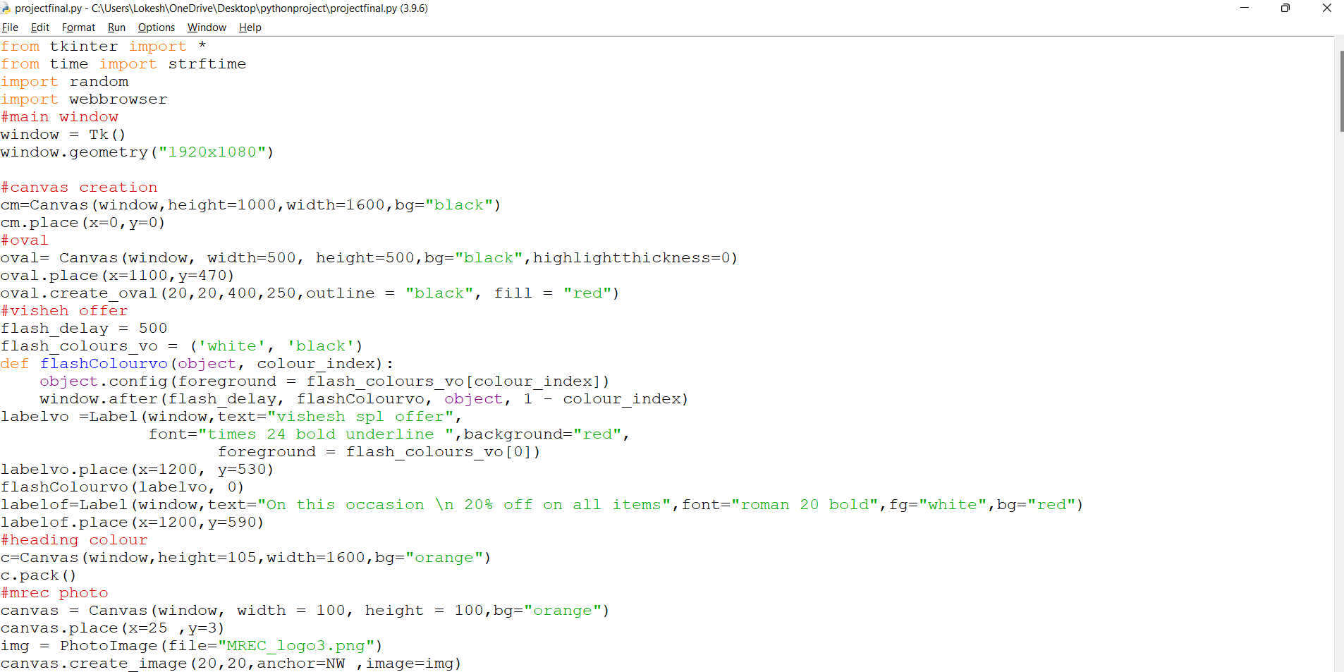
CODE

Slide 7
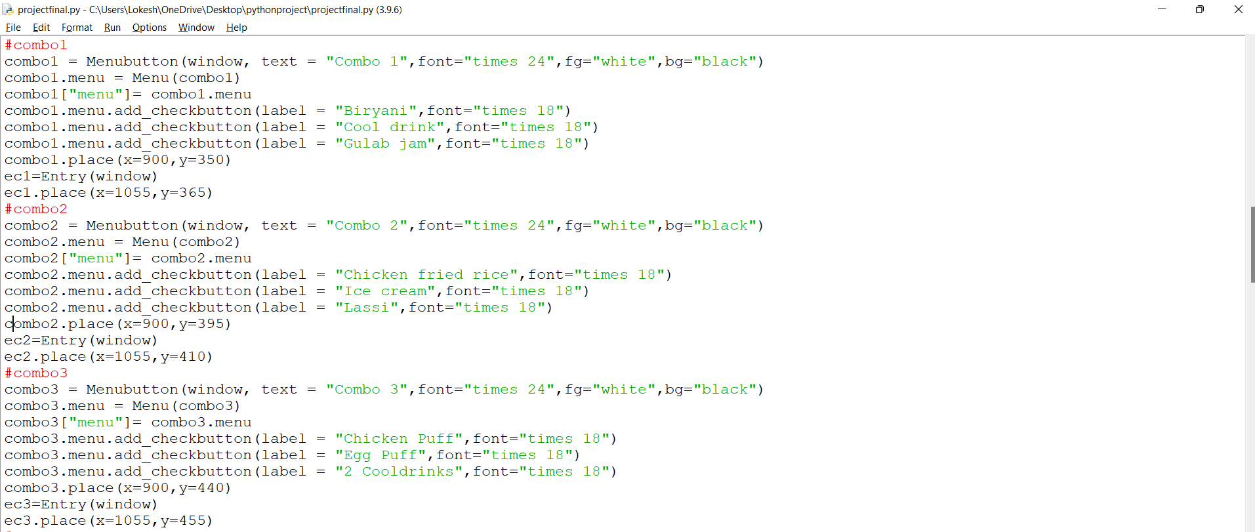

Slide 8
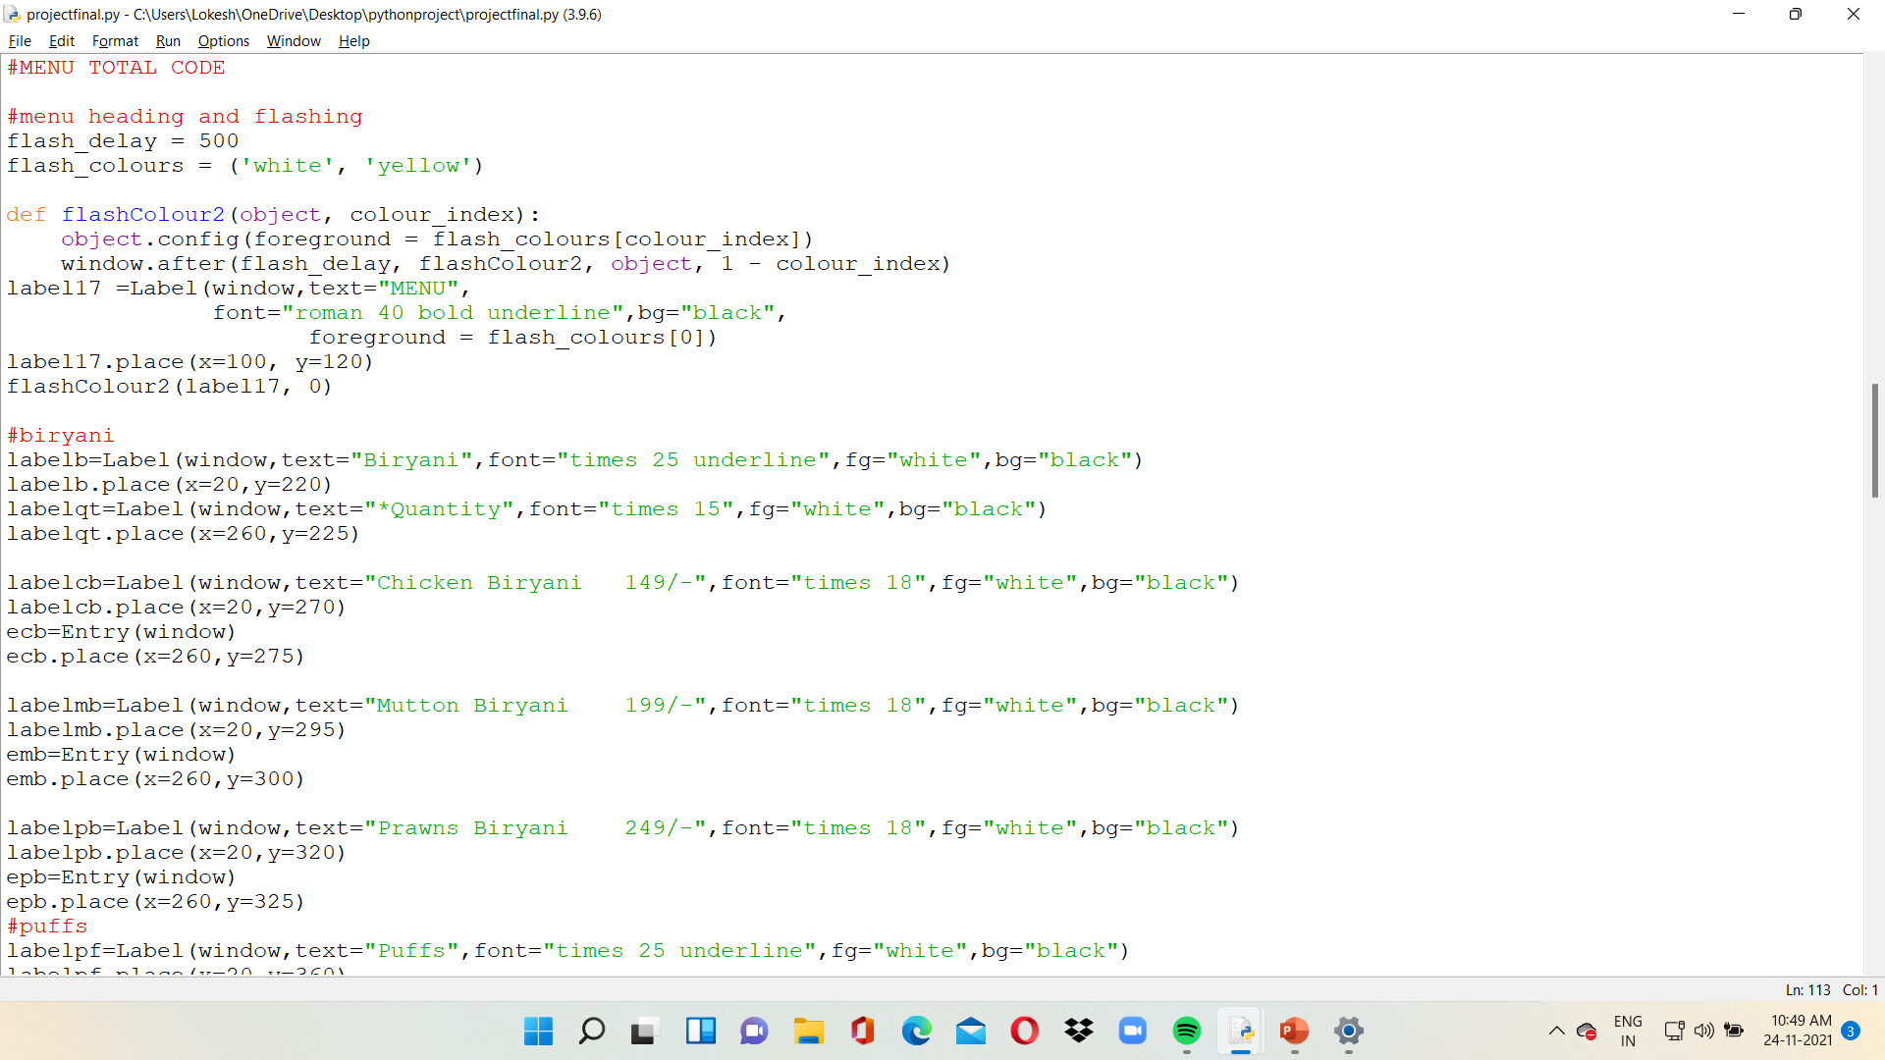

Slide 9
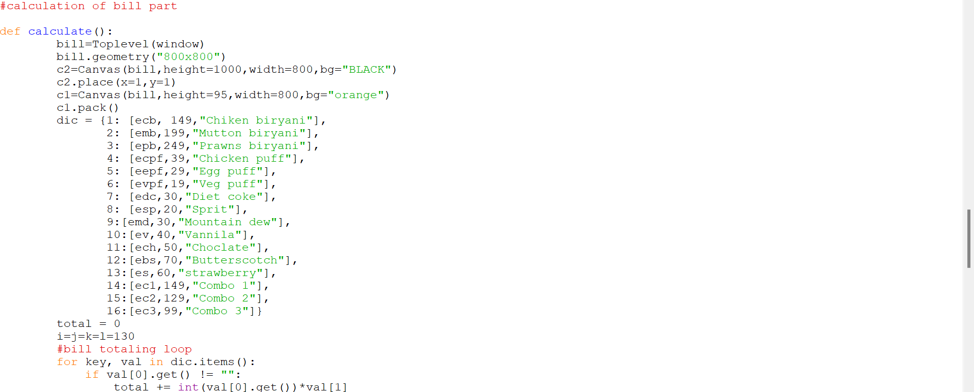

Slide 10
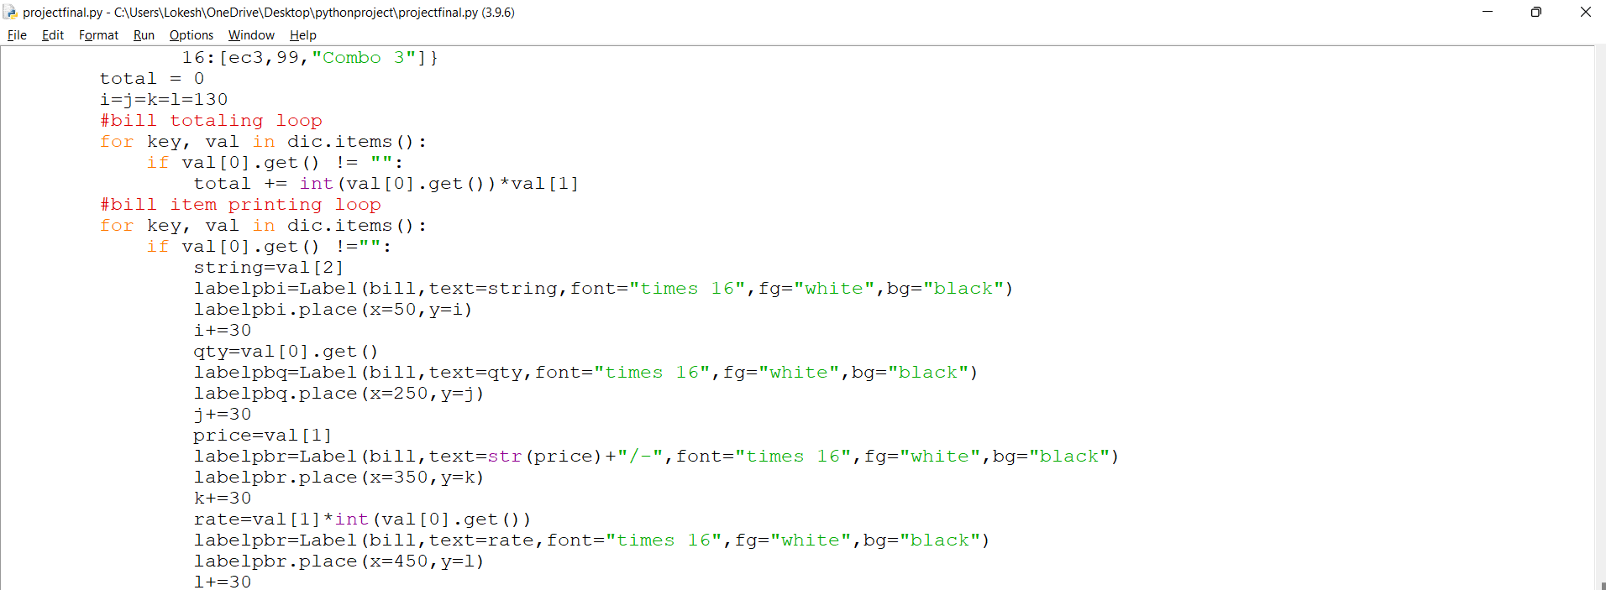

Slide 11
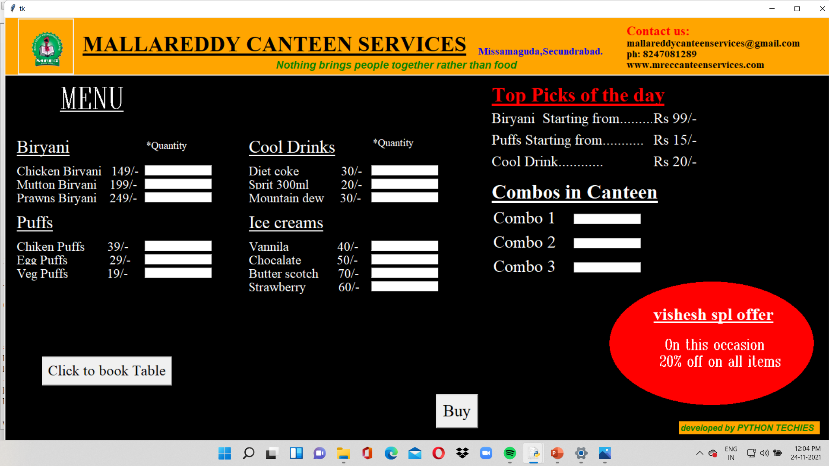
RESULT

Slide 12
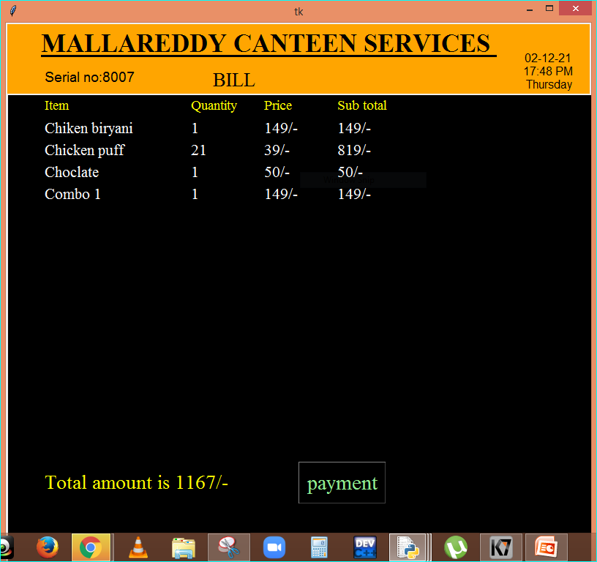

Slide 13
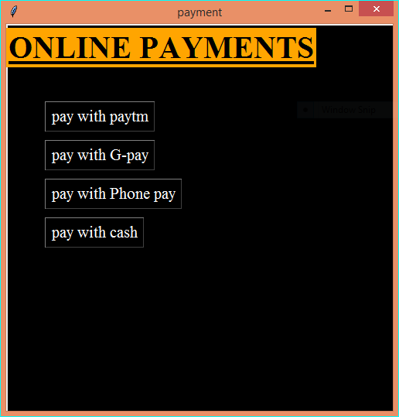

Slide 14
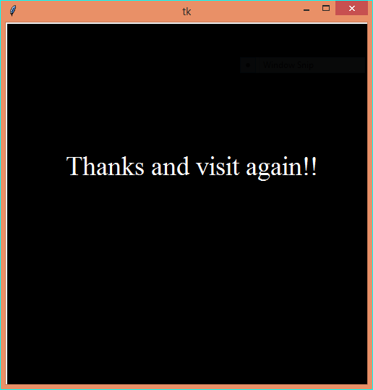

Slide 15
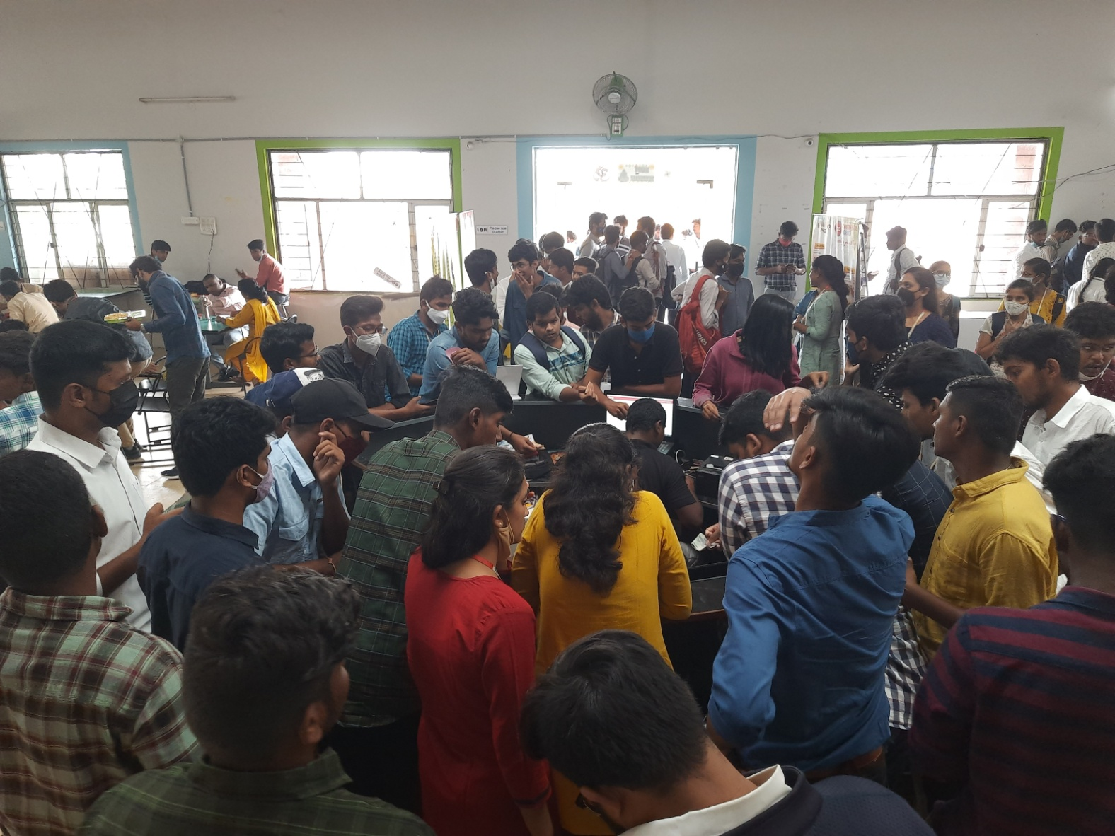
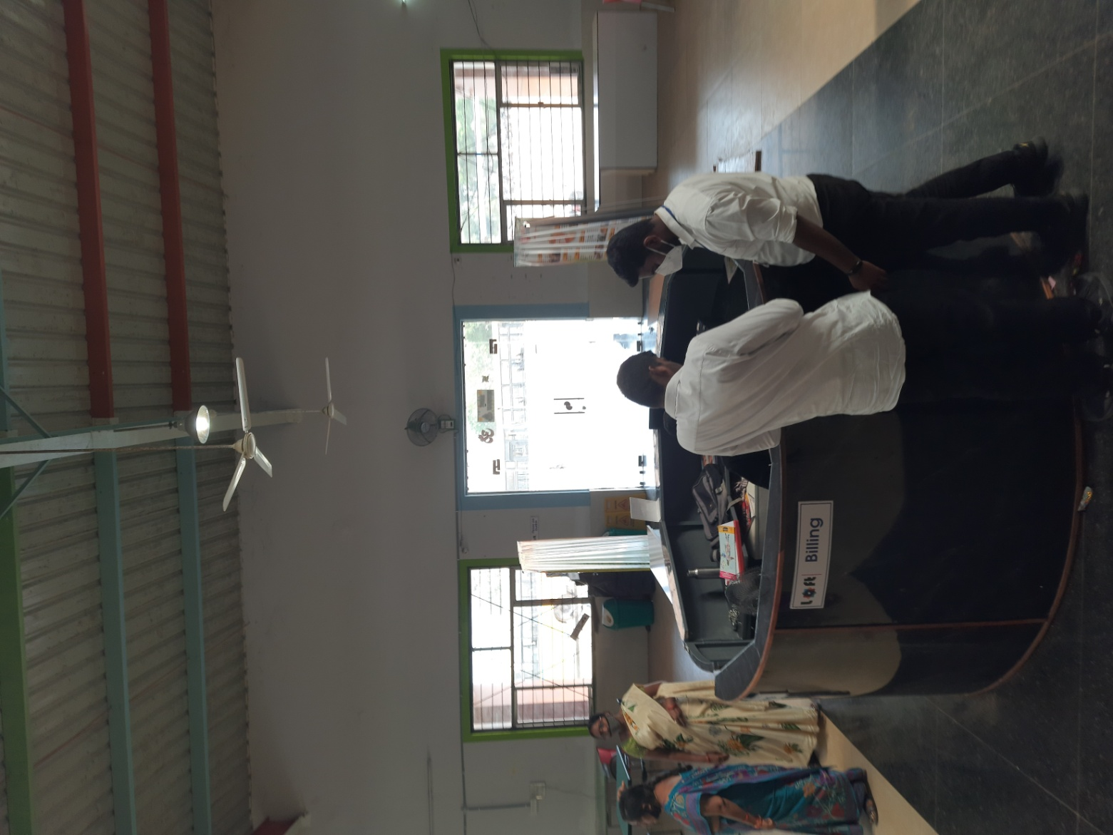
ASSUMPTIONS
BEFORE SENARIO
AFTER SENARIO

Slide 16


